Slide 1
Deep Dive: Video Game Localization Trends on Steam
File created on: 29.03.2026 19:54:53

Slide 2
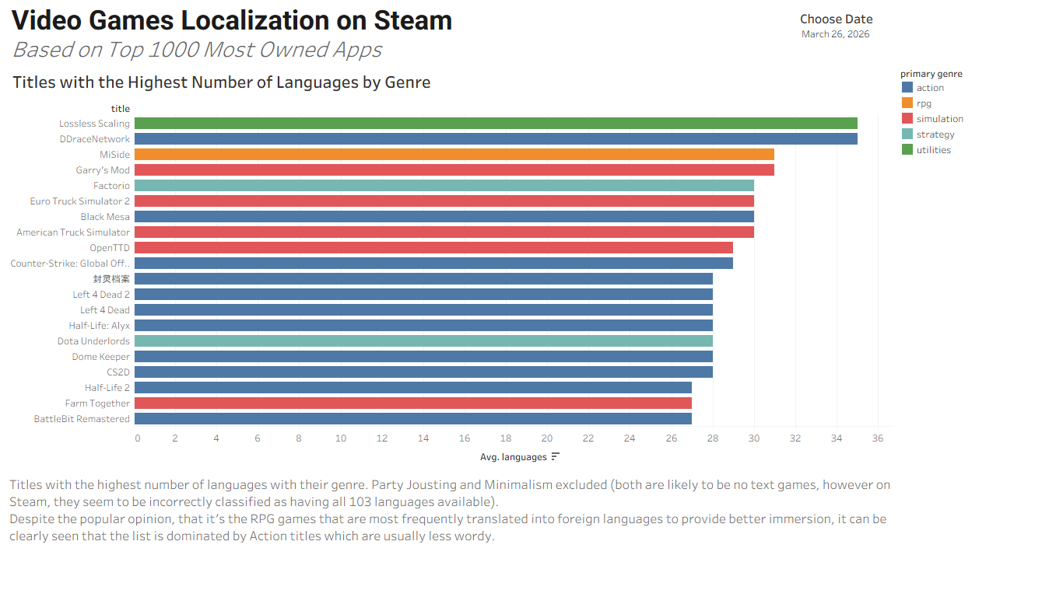

Slide 3
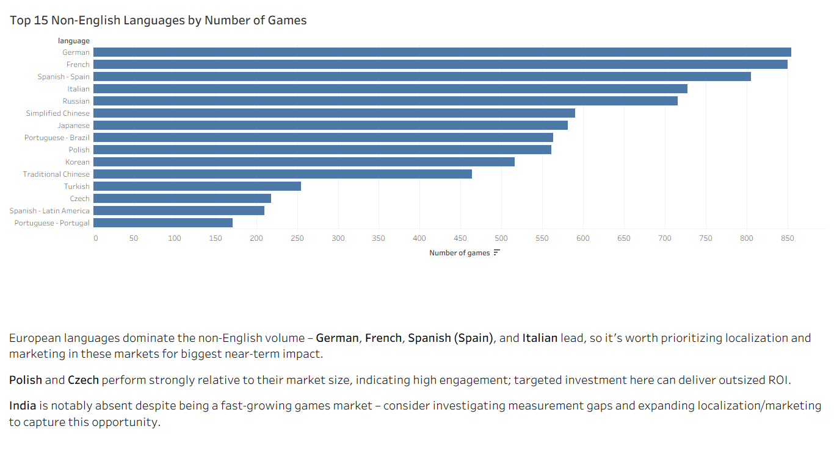

Slide 4
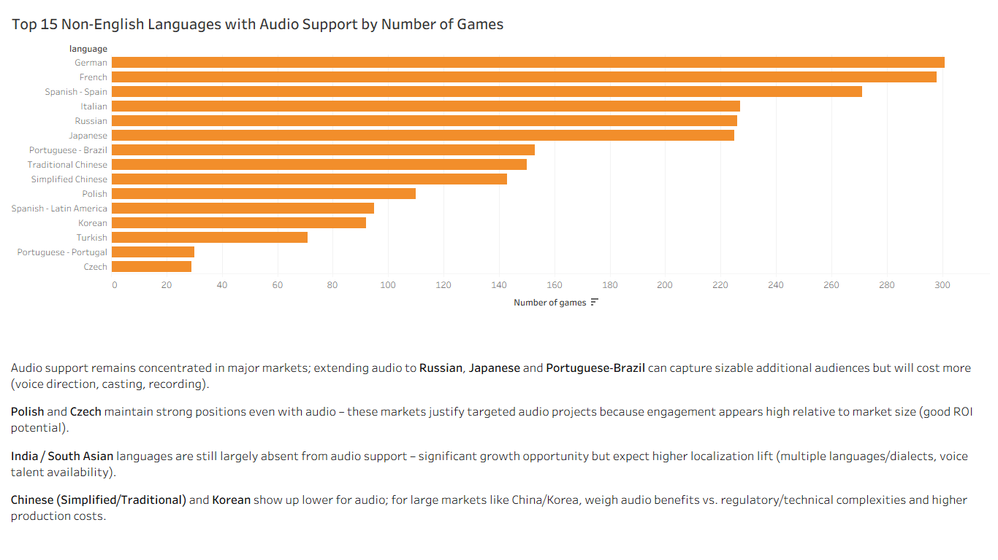

Slide 5
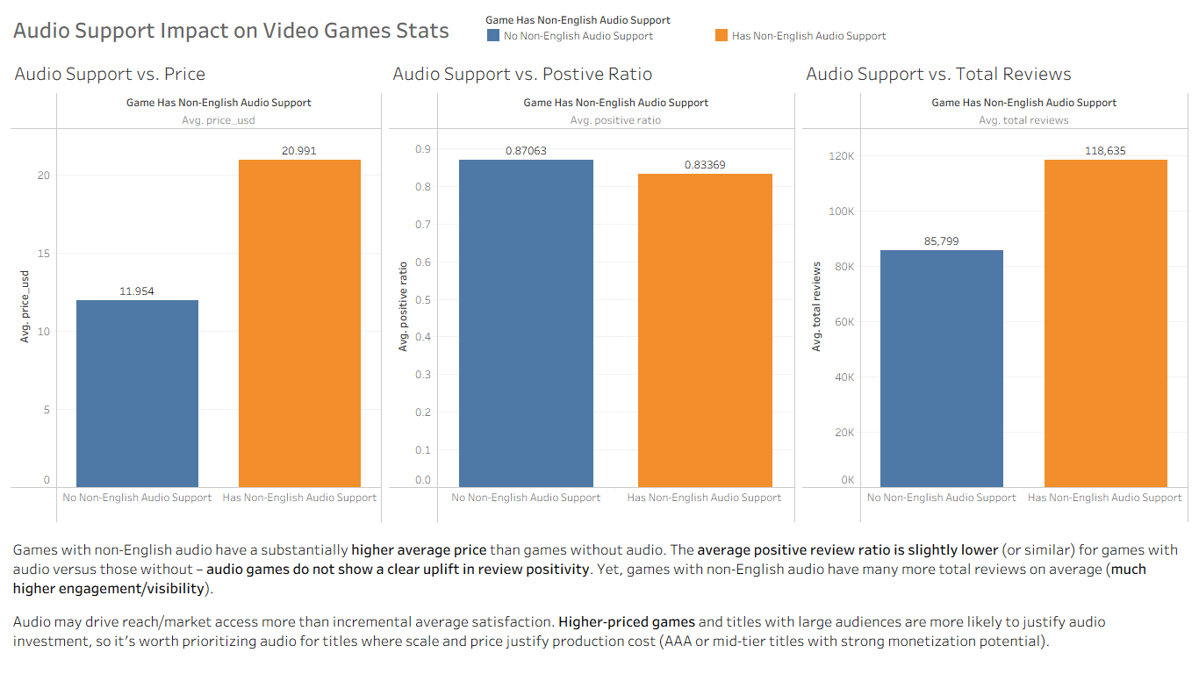

Slide 6
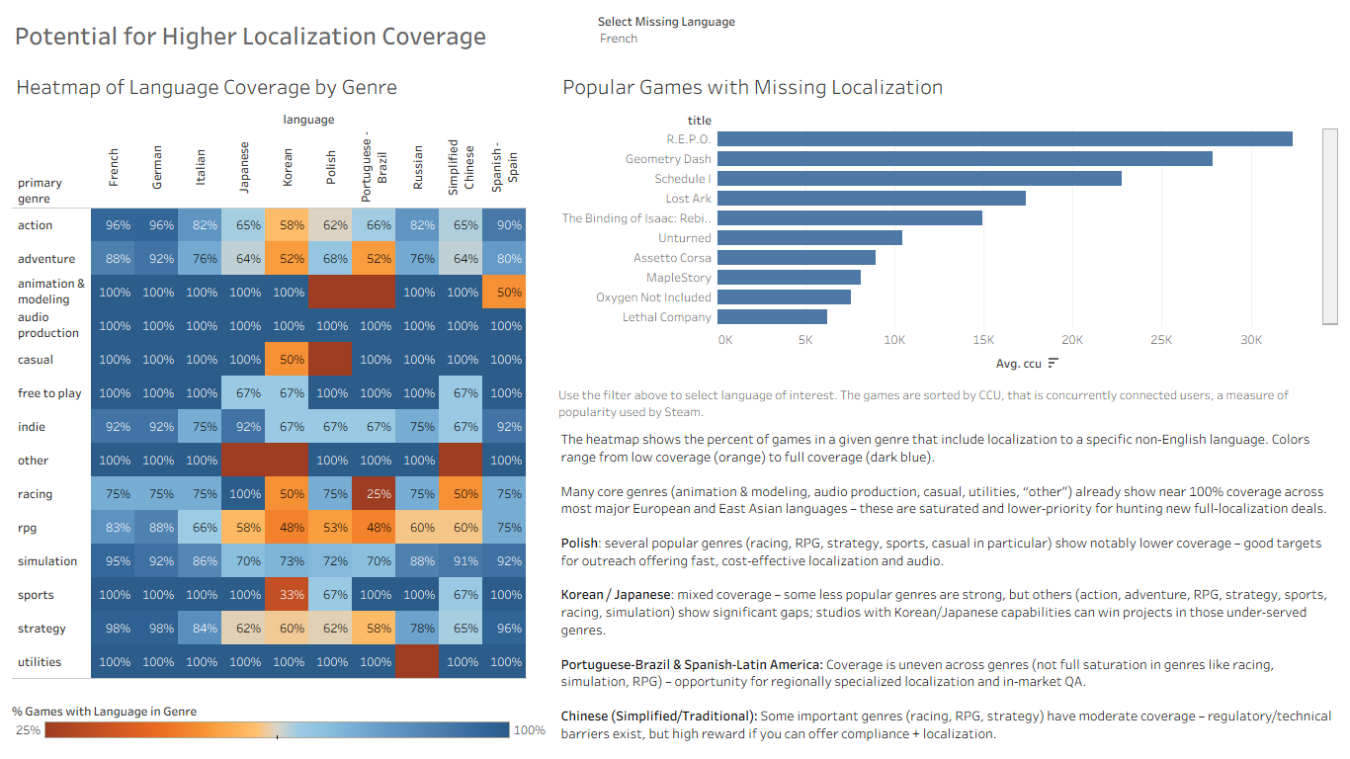

Slide 7
